Slide 1

8- queens problem

Slide 2
8 queen problem definition
We have given an 8x8 chessboard, find a way to place 8 queens such that no queen can attack any other queen on the chessboard.
A queen can only be attacked if it lies on the same row, or same column, or the same diagonal of any other queen
Print all the possible configurations.

Slide 3
To solve this problem, we will make use of the Backtracking algorithm.
The backtracking algorithm, in general checks all possible configurations and test whether the required result is obtained or not.
For the given problem, we will explore all possible positions the queens can be relatively placed at.
The solution will be correct when the number of placed queens = 8.
The time complexity of this approach is O(N!).

Slide 4
Idea
8x8 chess board
All solutions to the 8-queens problem can therefore be represented as 8-tuples (x1,..,.x8) each Xi is the column on which queen ith is placed.
Let (x1,x2…x8) represent a solutions
All xi’s will be distinct since no two queens can place in same column
Therefore the solution space consists of 8^8, 8-tuples
The explicit constrains using this formulation are Si = {1,2,3,54,6,,7, 8}, 1< i < 8
The implicit constraint for this problem are that no two xi-s can be the same(i.e.all queensmust beon different columns)and no two queens canbe on the same diagonal

Slide 5
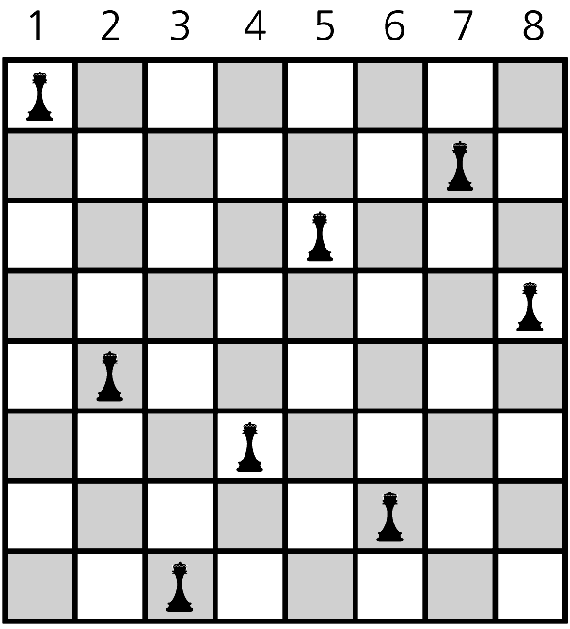

Slide 6
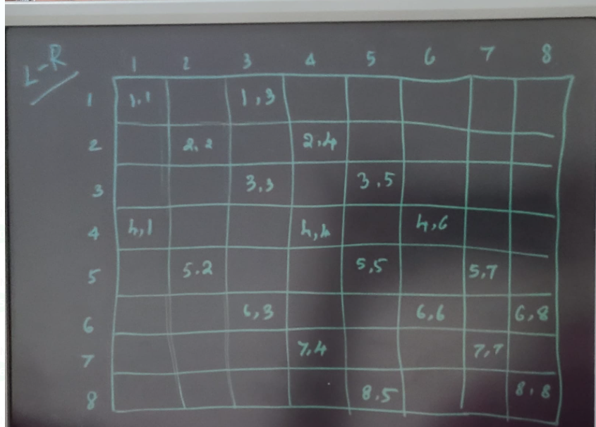
Top left to bottom right diagonal position

Slide 7
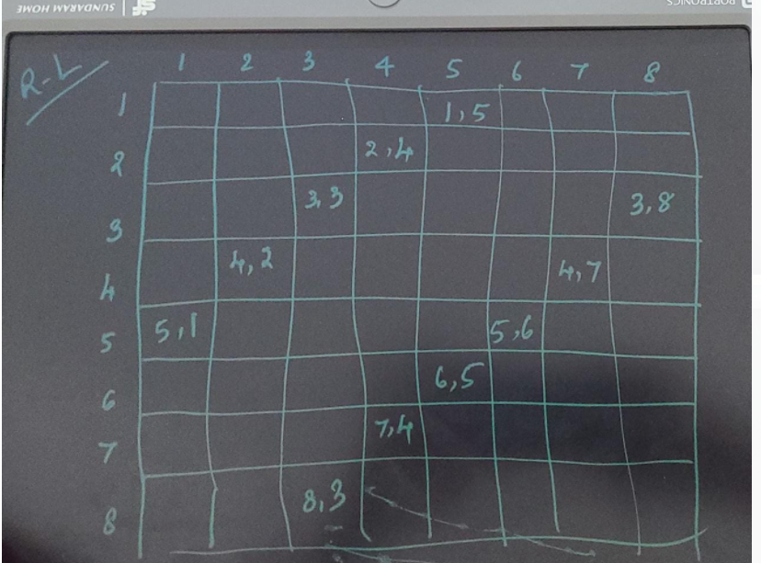
Top right to bottom left diagonal position

Slide 8
Chess board is considered as two dimensional array a[1..n][1..n]
Condition to check whether queens are diagonal
Consider 8 ×8 chessboard
Let queen be at[4,2]
Squares at diagonal to this queen(upper left to lower right]
a(3,1) , a(5,3),a(6,4),a(7,5),a(8,6)
(from upper right to lower left)
a(5,1),a(3,3),a(2,4),a(1,5)

Slide 9
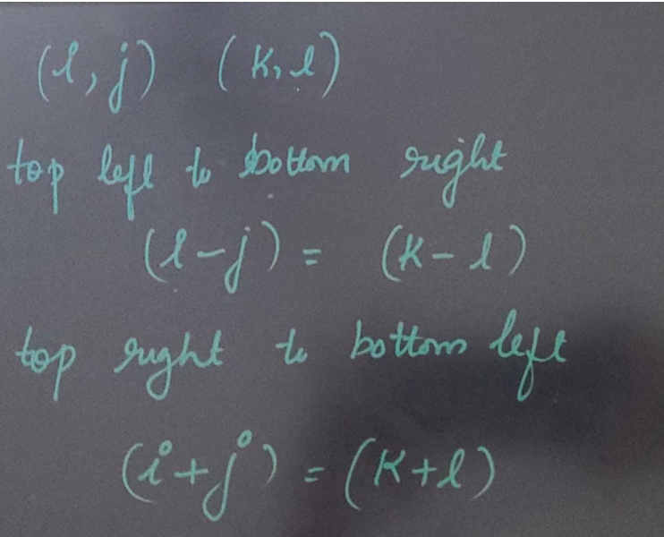

Slide 10
If two queens are placed at position(i,j) and (k,l)
(i-l)=(k-j) from eq 1
-(l-i)=-(j-k) from eq 2
So can write commonly as
l l-i l= l j-k l condition that two queens are t diagonal

Slide 11
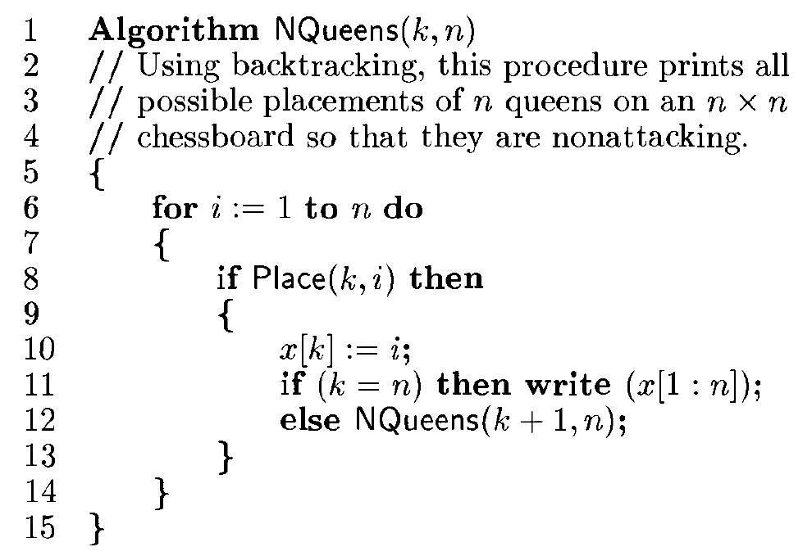

Slide 12
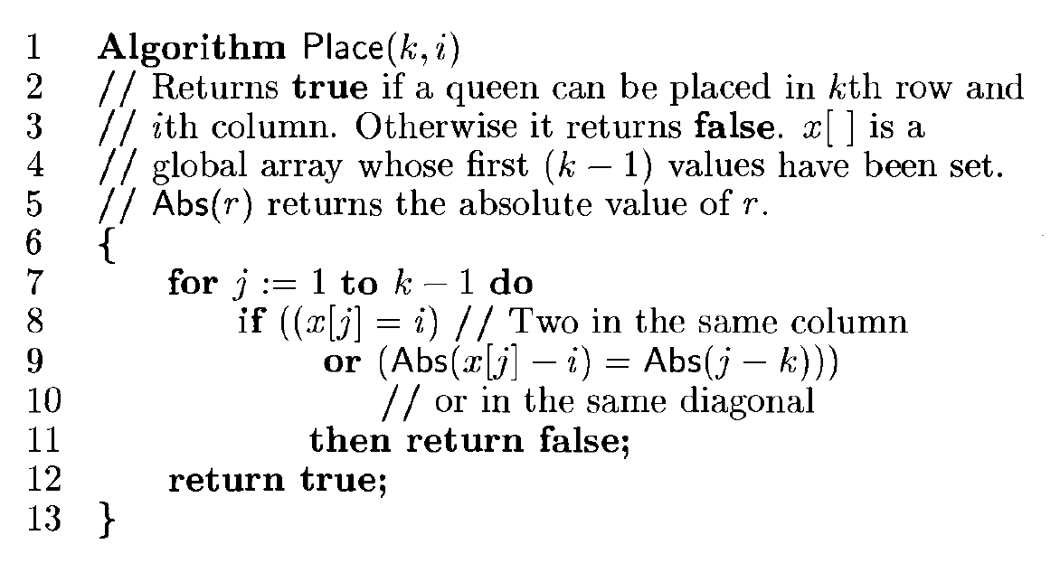

Slide 13

1
2
3
4
5
6
7
8

Slide 14
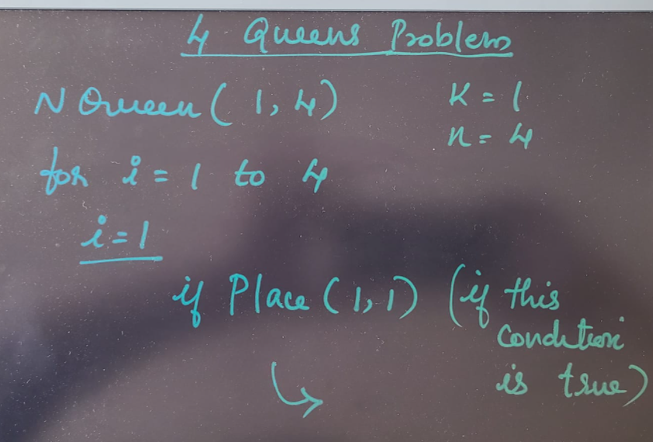
Example – 4 queens' problem
First call to algorithm is Nqueen(1,4)

Slide 15
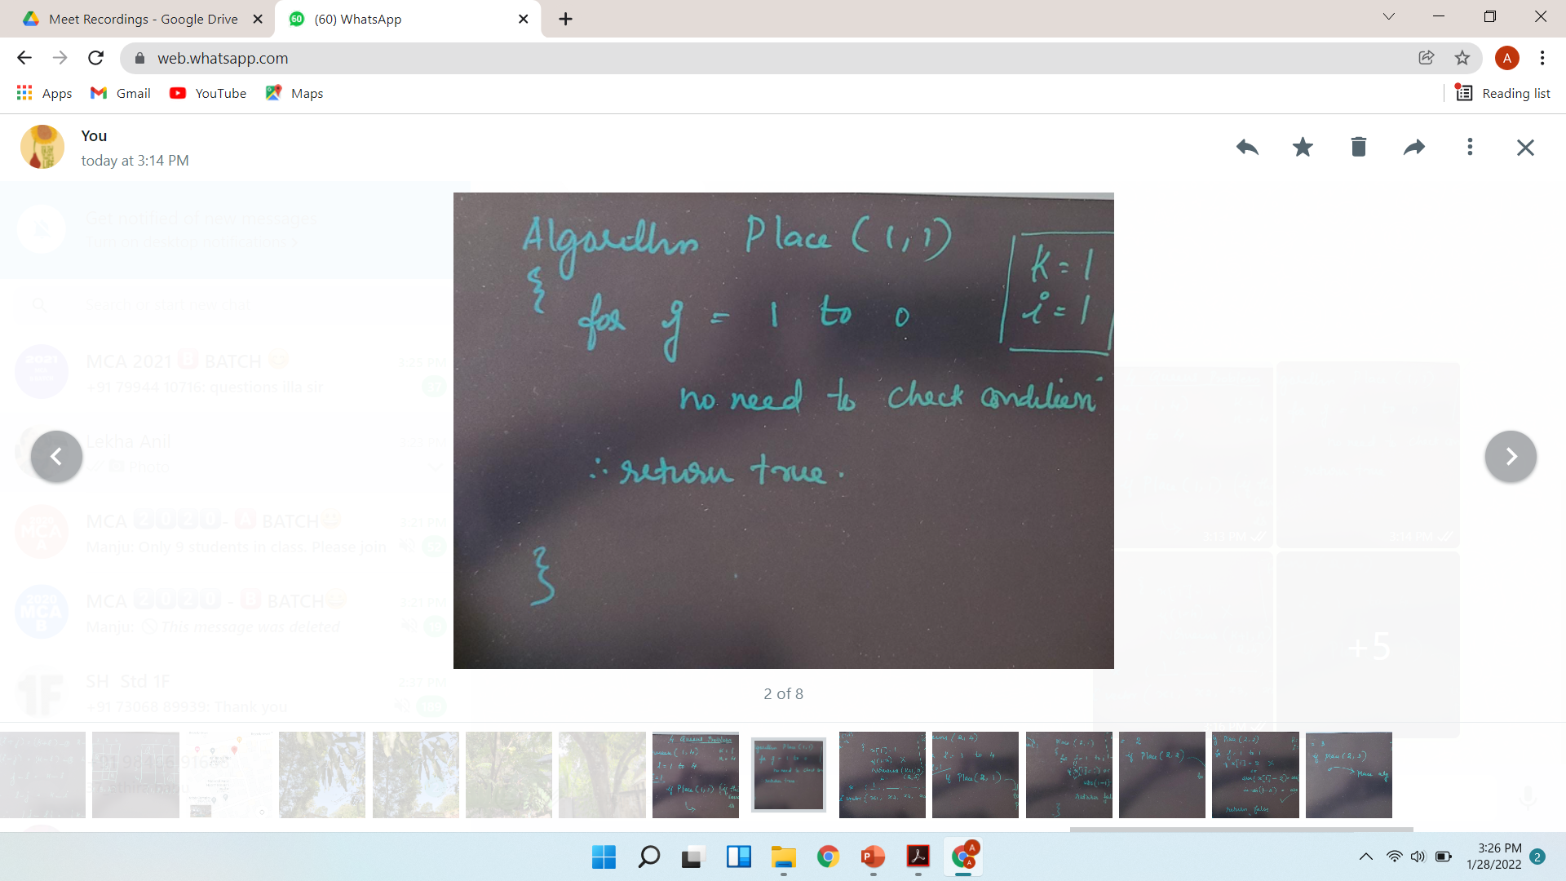
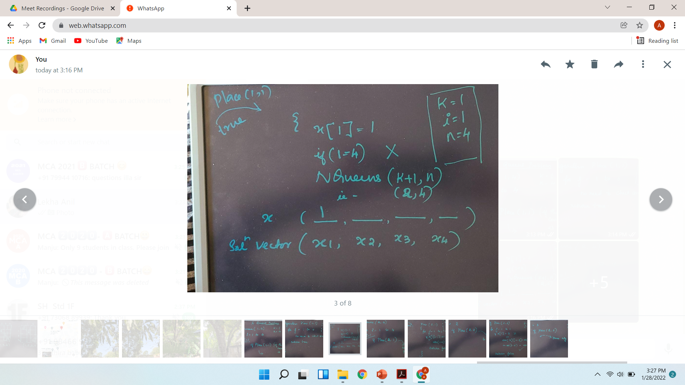

Slide 16
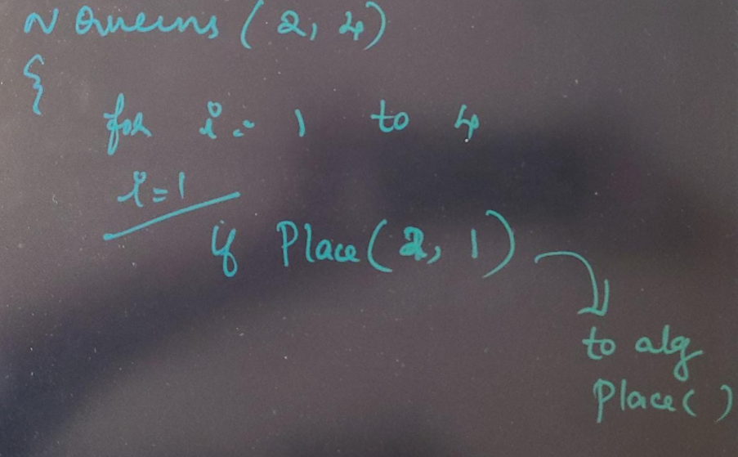

Slide 17
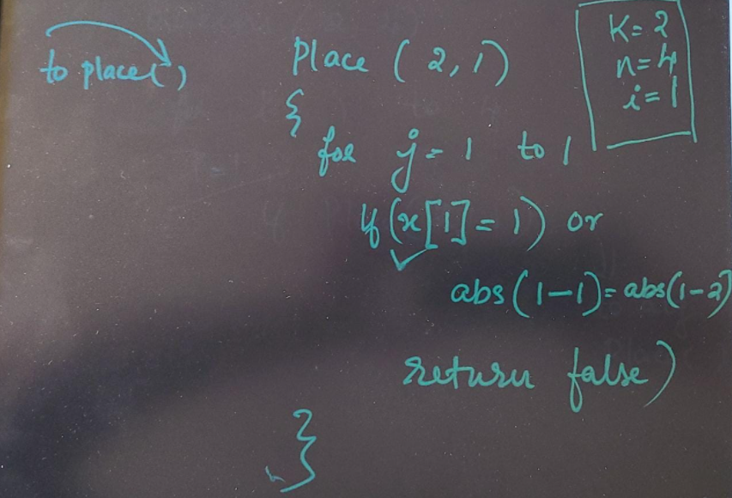

Slide 18
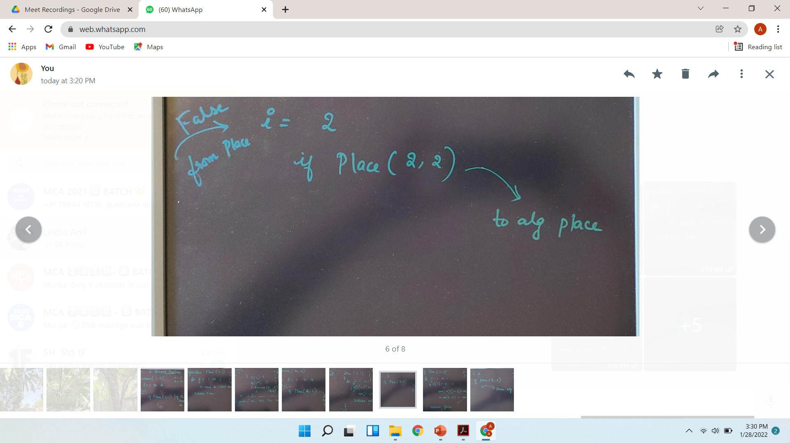
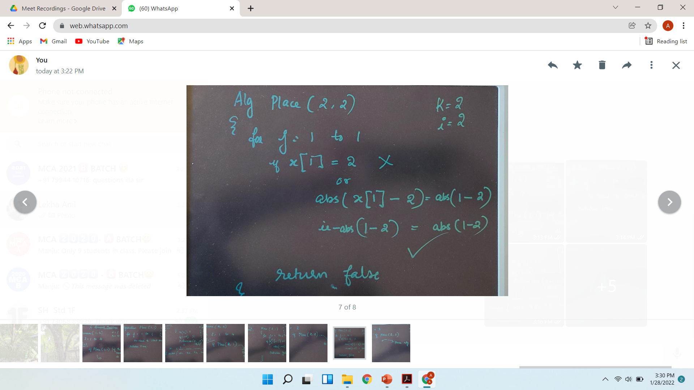

Slide 19
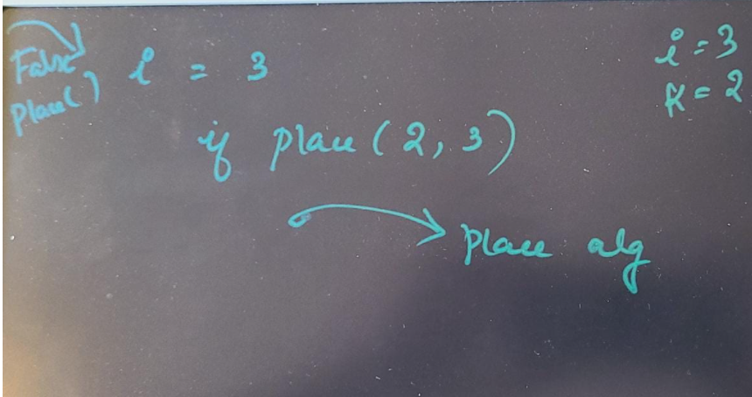

Slide 20
Place(k,i) returns a boolean value
It is true if k-th queen can be placed in column i
Also test if i distinct from all previous values x[1],….x[k-1] and whether there is no other queen on the same diagonal
X[] is a global array
Algorithm is invoked by Nqueens(1,n)

Slide 21
A solution to 8 queens problem

